Slide 1


Slide 2
Overview
What is Firebase?
Features of firebase
Analytics
How to develop high quality apps?
How to grow your user base?
Types of firebase

Slide 3
Firebase
What is Firebase and why it is used?
The Firebase Realtime Database lets you build rich, collaborative applications by allowing secure access to the database directly from client-side code. Data is persisted locally, and even while offline, realtime events continue to fire, giving the end user a responsive experience.

Slide 4
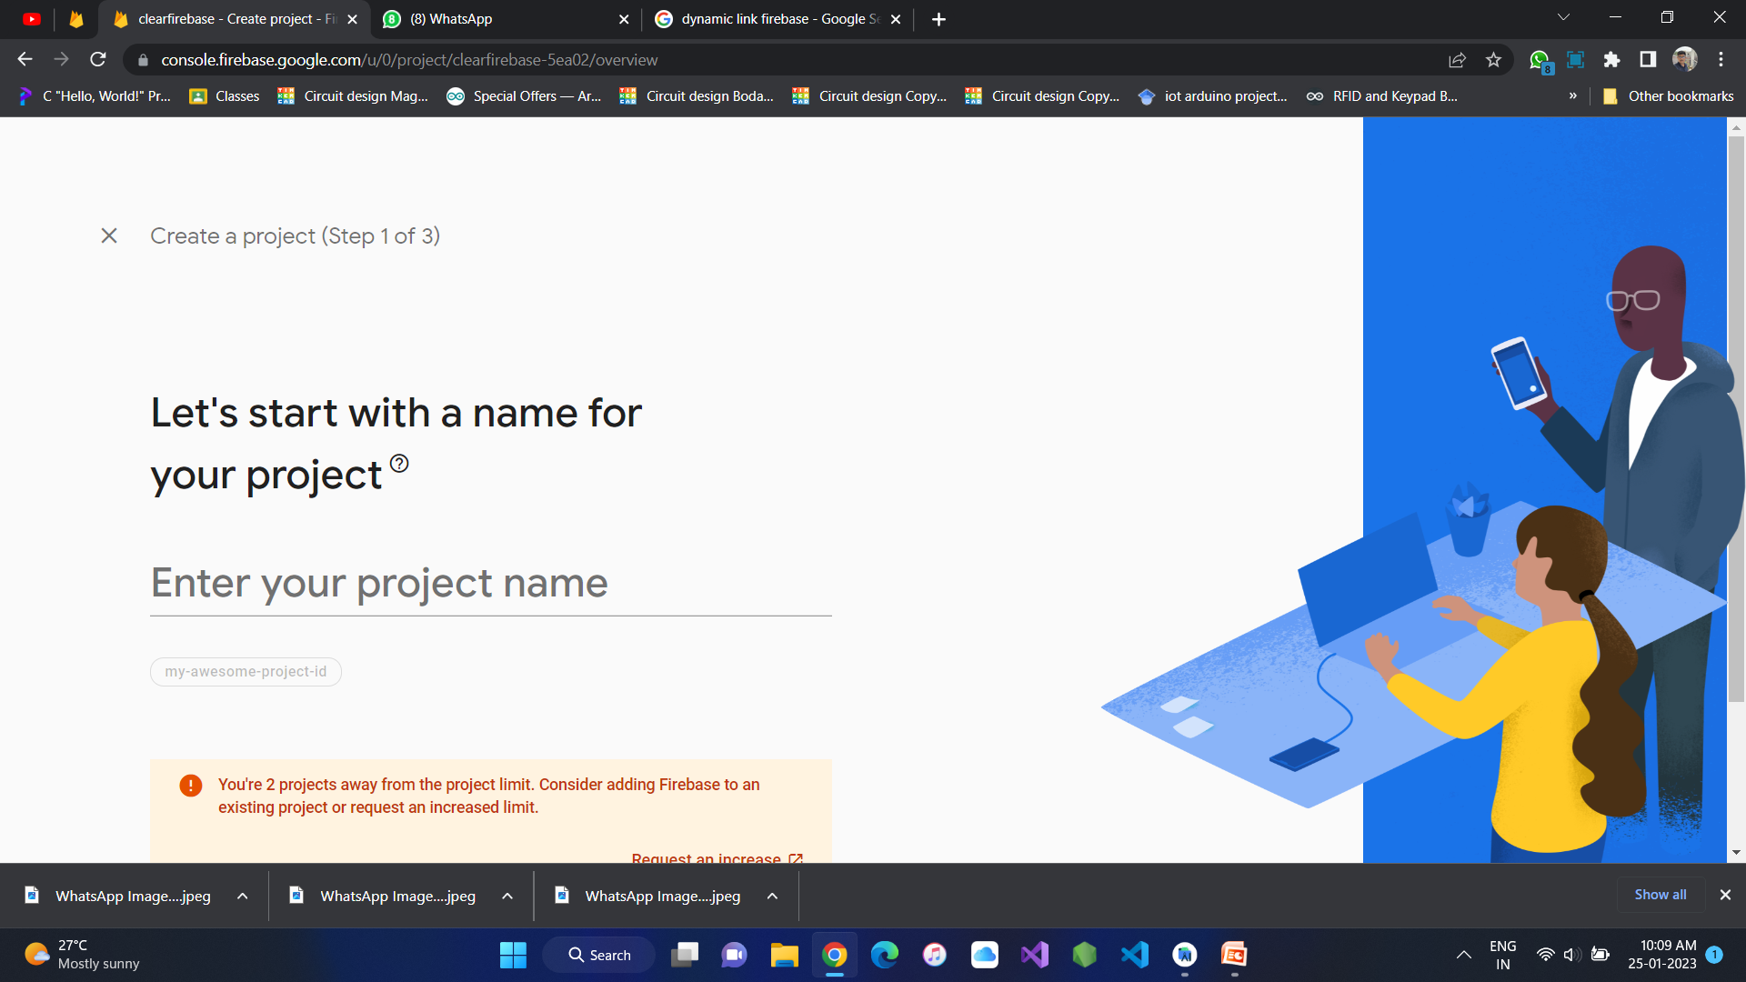
Project creation

Slide 5
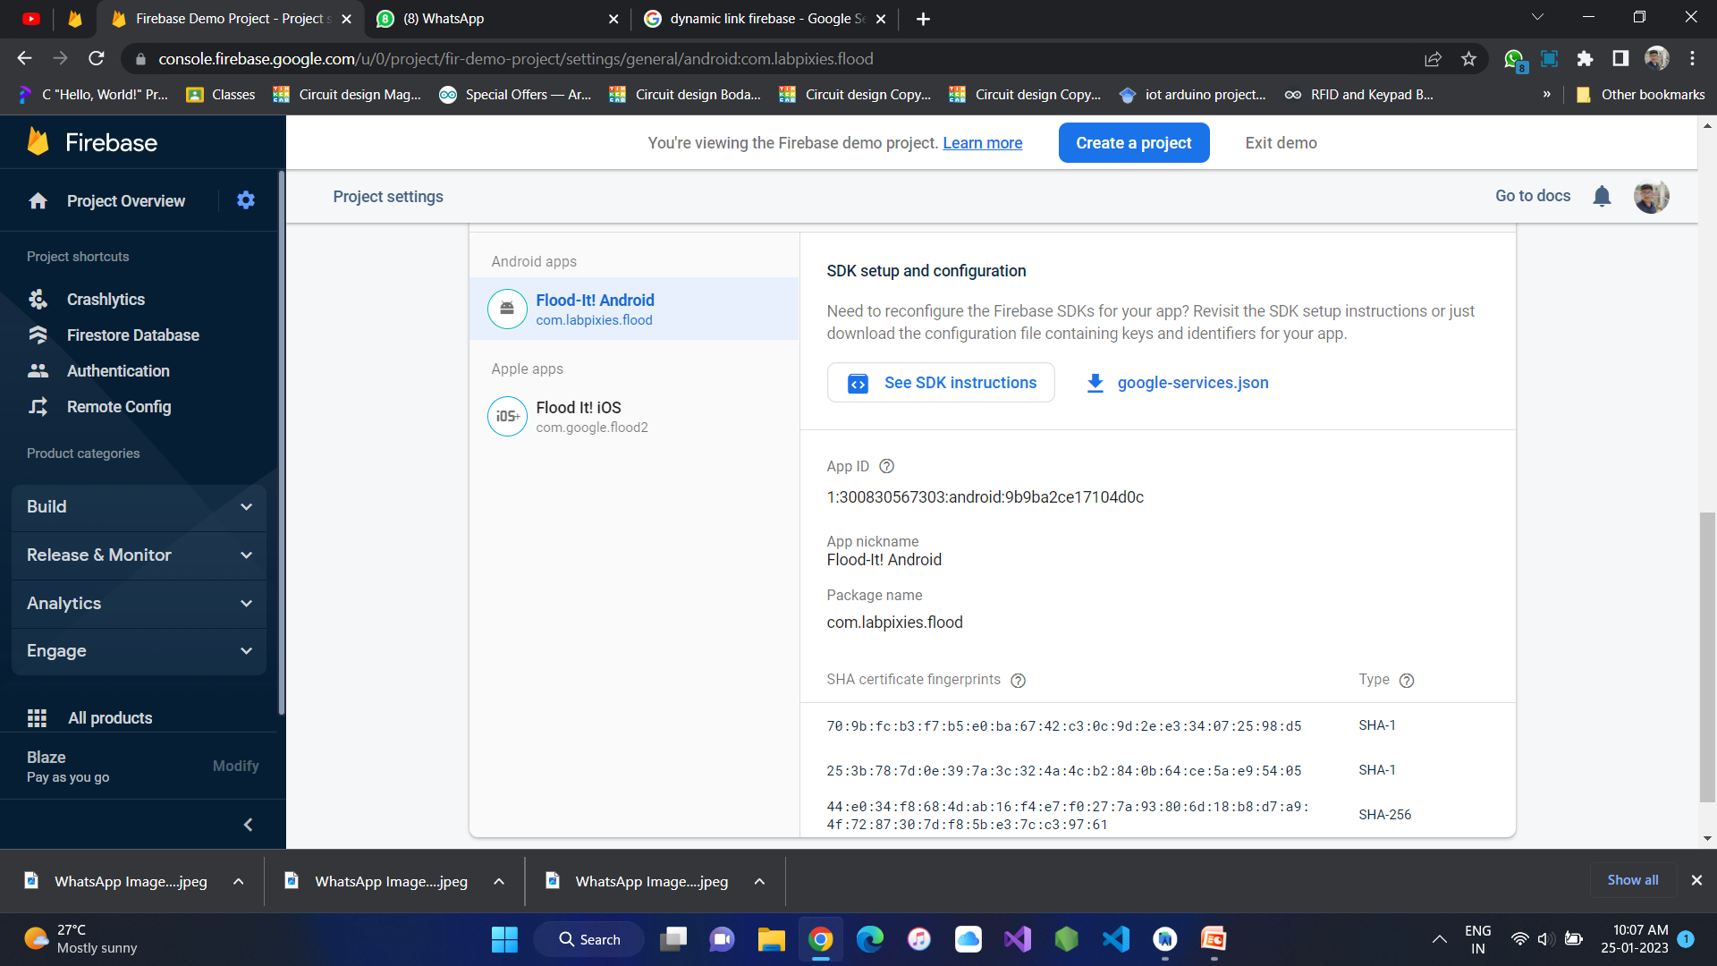
App creation

Slide 6
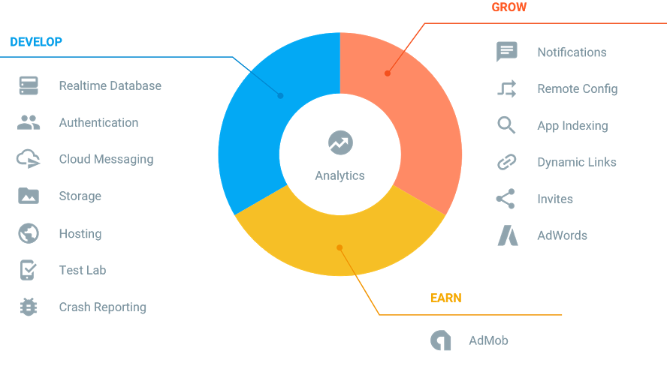
What is Firebase?
Realtime Application Platform

Slide 7
Feature of firebase
Forget about infrastructure
Work across platforms
Free to start, scale with ease
Get free support

Slide 8

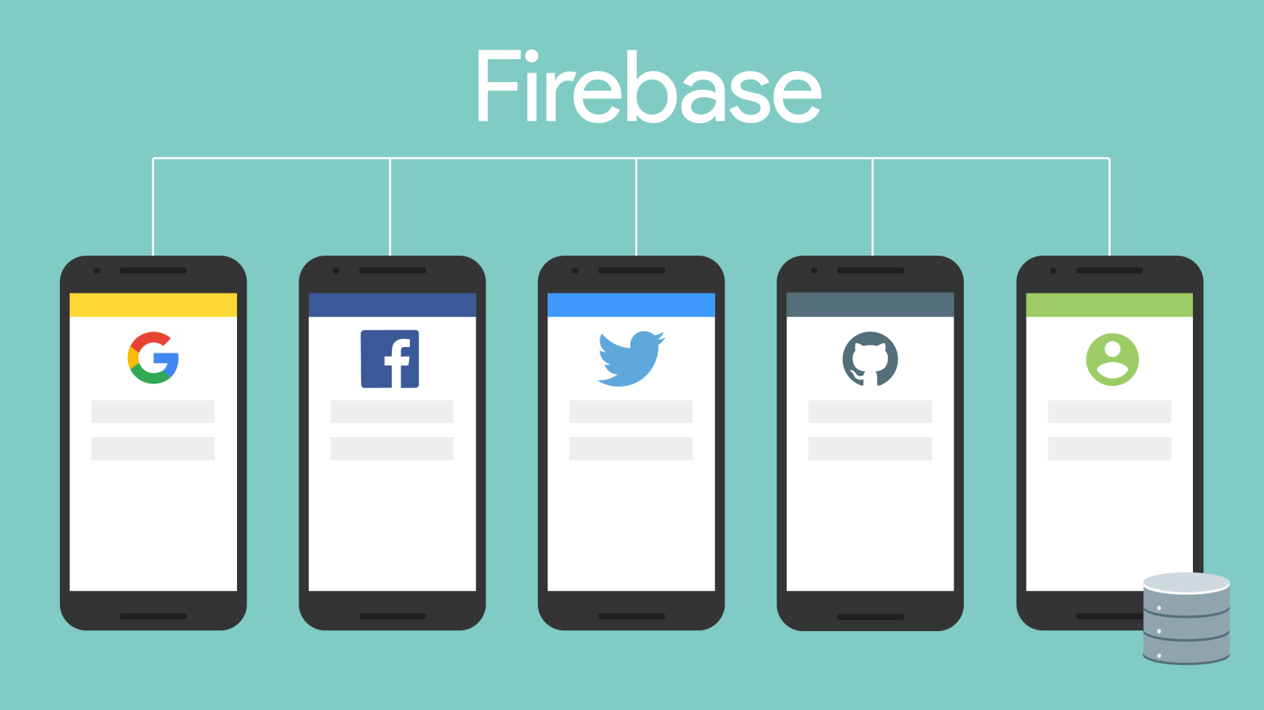
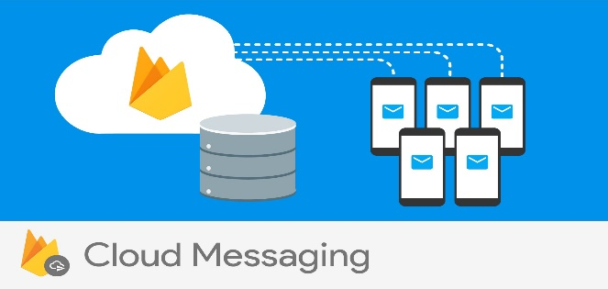
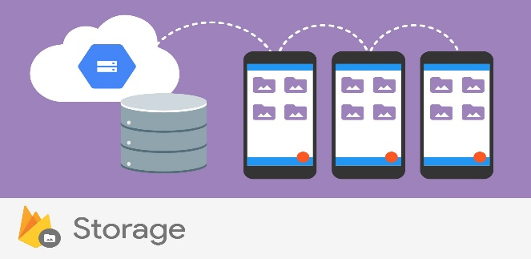
DEVELOP
Realtime Database
Store and sync app data in
realtime
Authentication
Reduce friction with robust
authentication
Cloud Messaging
Deliver and receive messages
across platforms reliably
Storage
Store files with ease

Slide 9

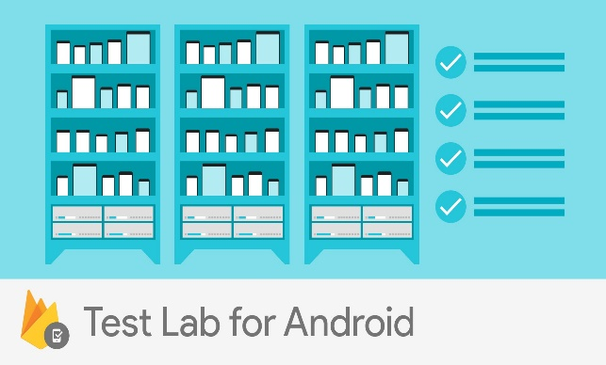

DEVELOP
Hosting
Deliver web content faster
Test Lab
Test in the lab, not on your
users
Crash Reporting
Keep your app stable

Slide 10
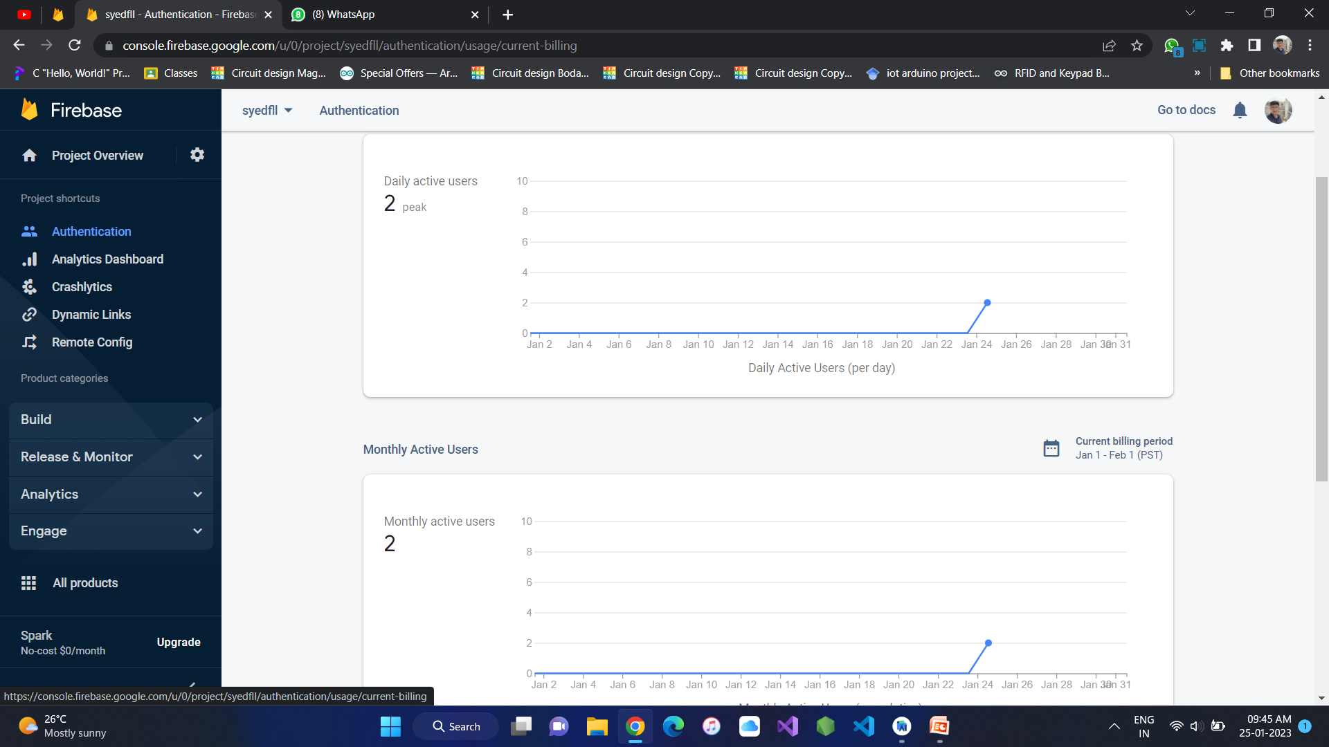
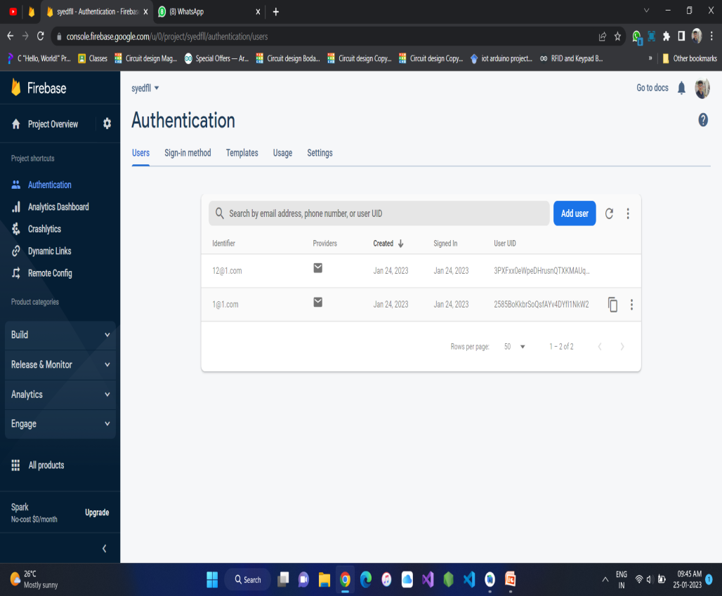
Authentication

Slide 11
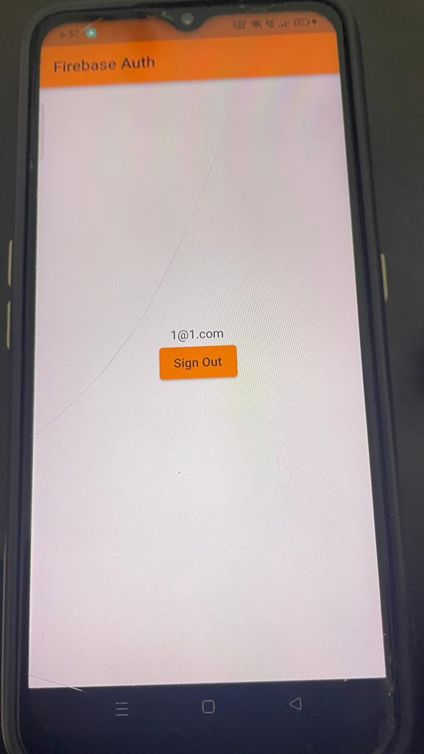
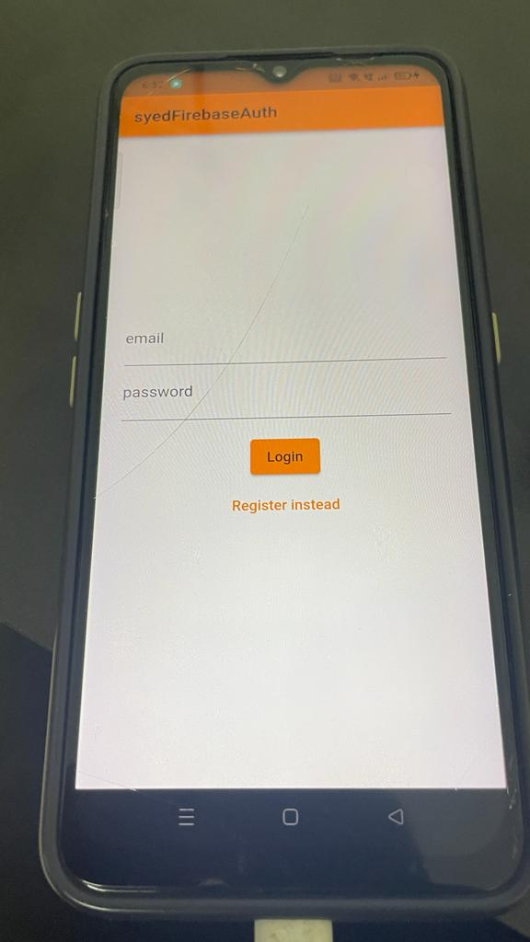
Authentication login

Slide 12
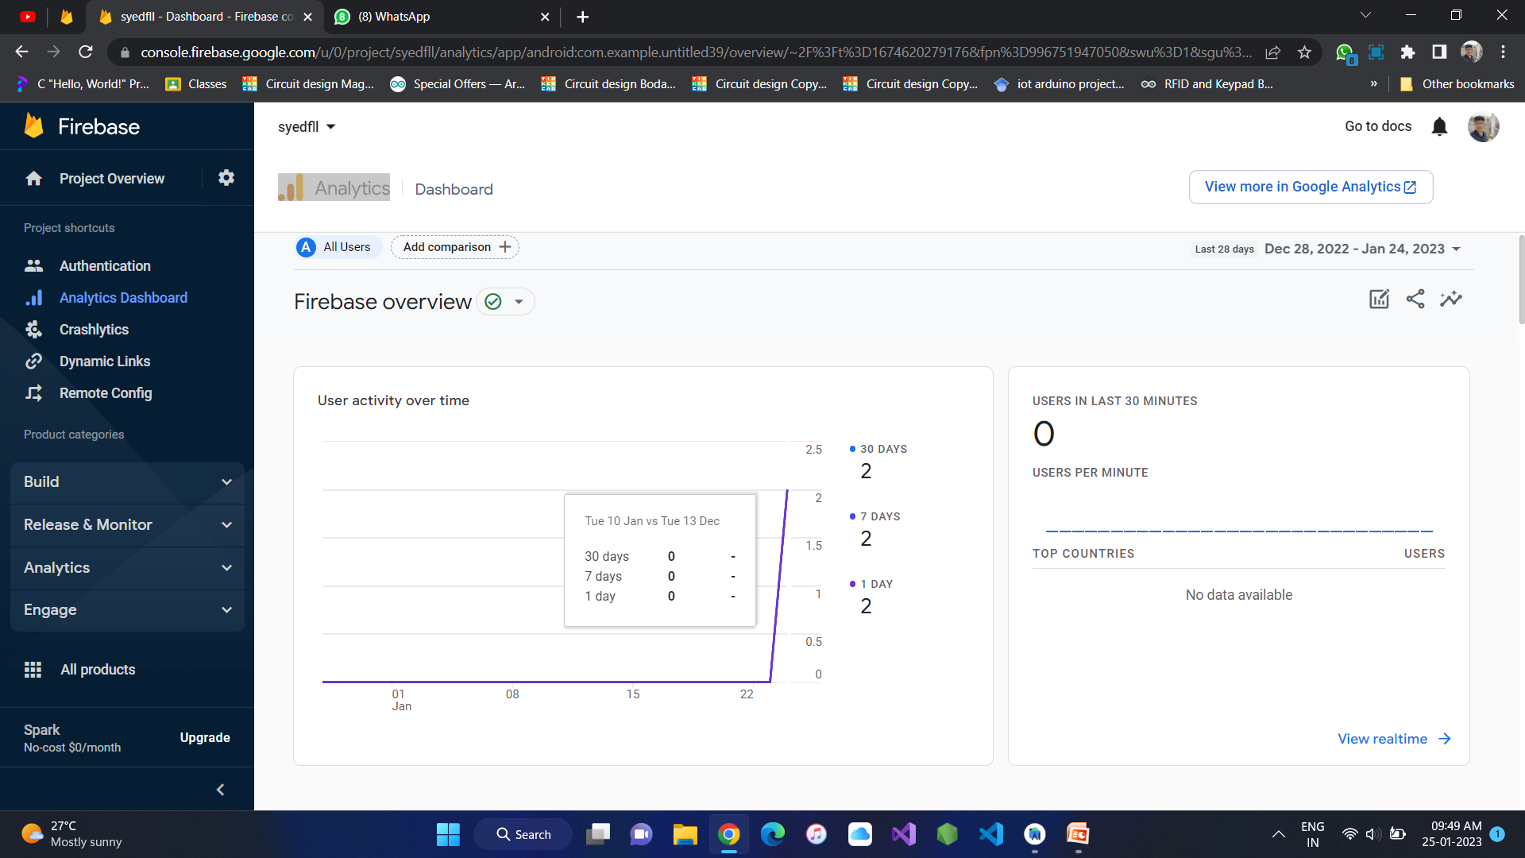
Analytics:

Slide 13
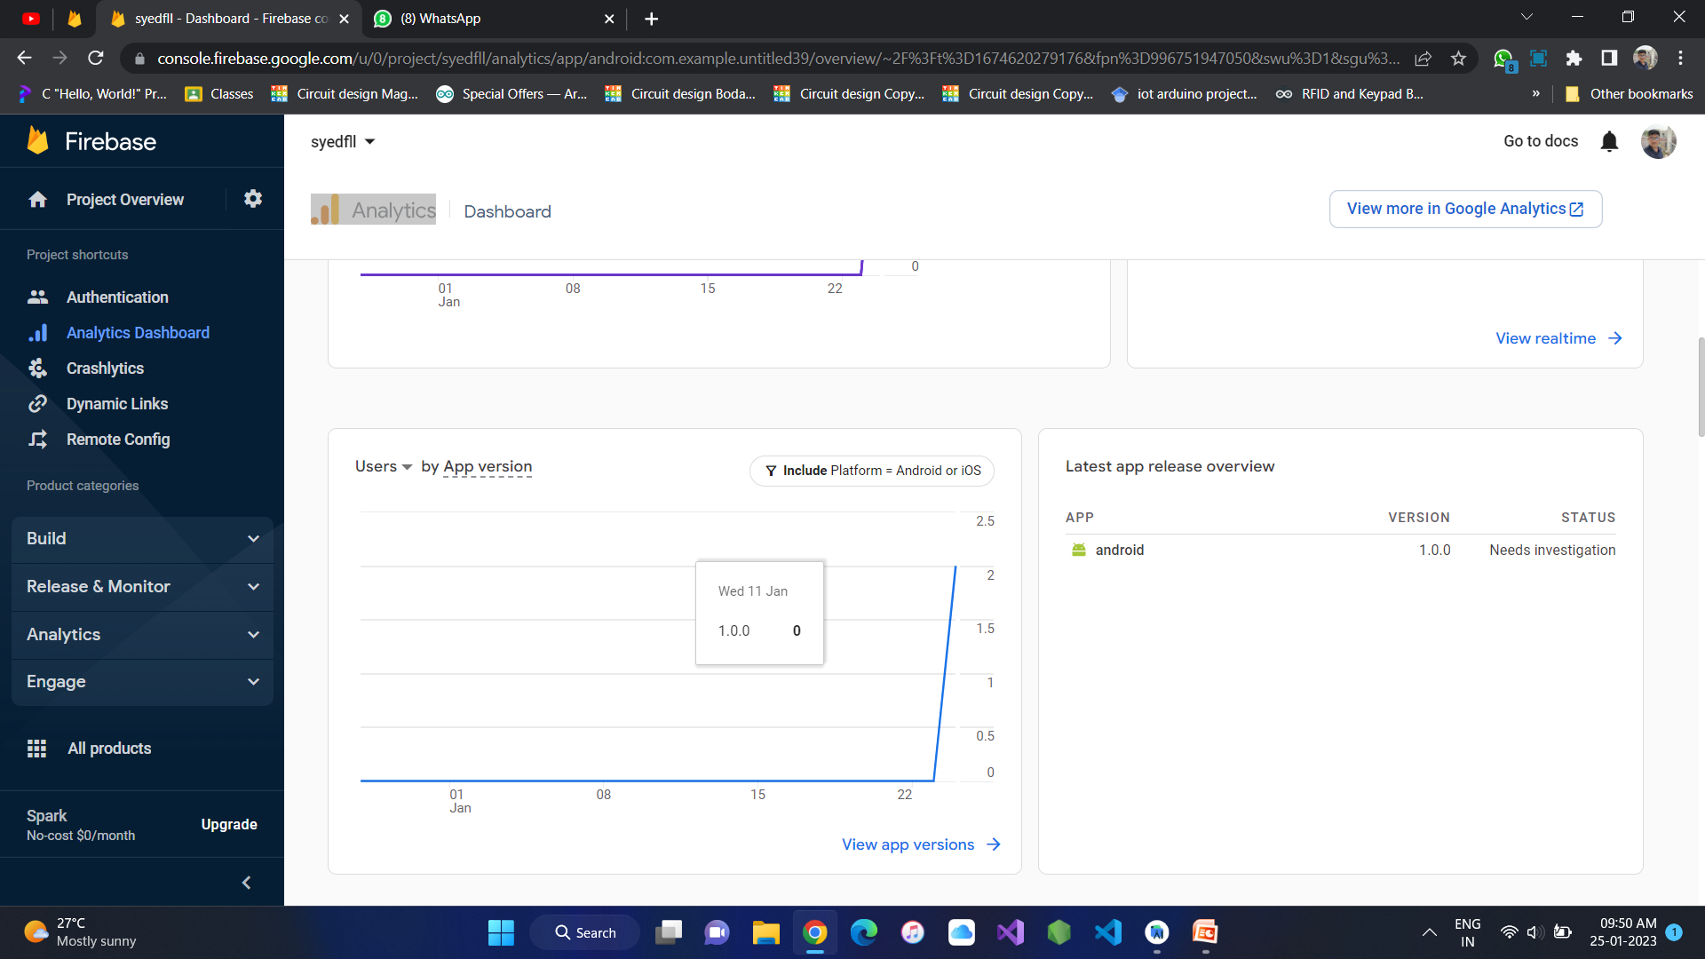
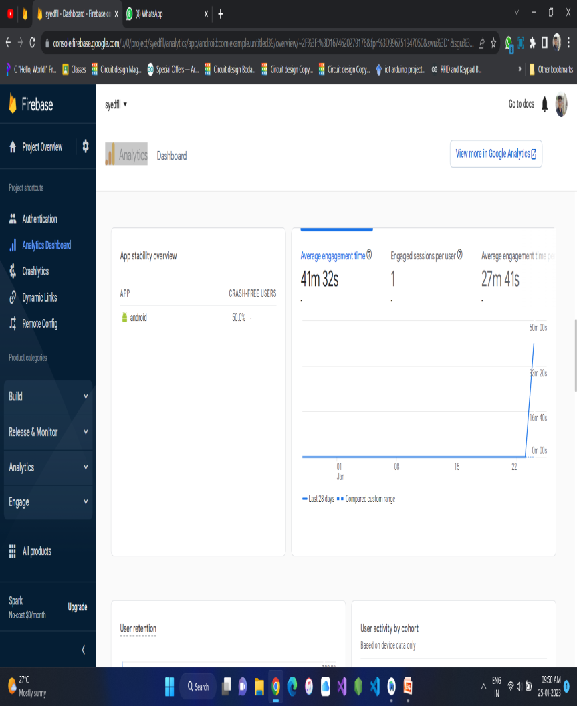

Slide 14
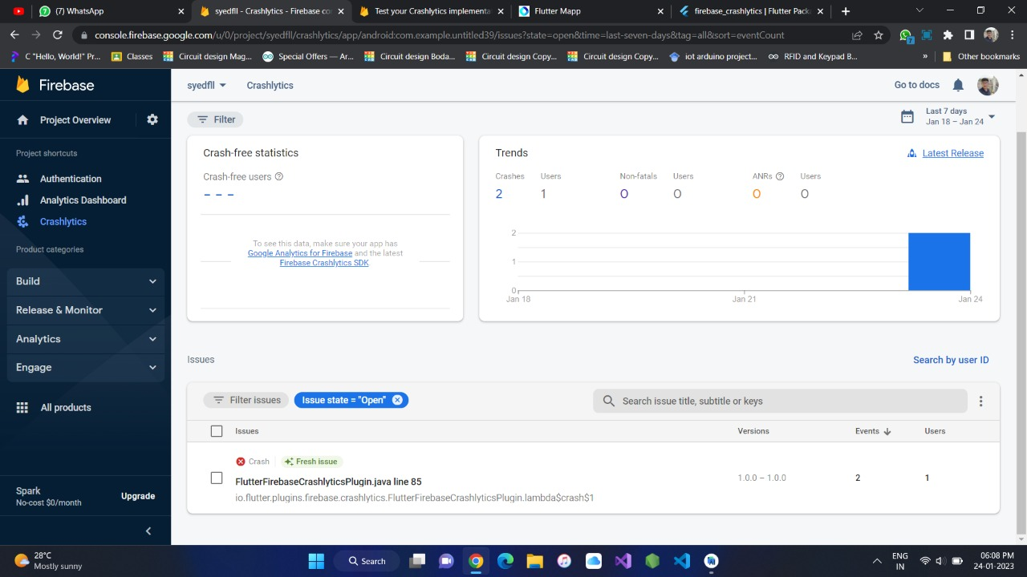
Crashlytics

Slide 15
Dynamic Link
Dynamic Links are deep links into an app that work whether or not users have installed the app yet. When users open a Dynamic Link into an app that is not installed, the app's Play Store page opens, where users can install the app. After users install and open the app, the app displays the deep-linked content.

Slide 16
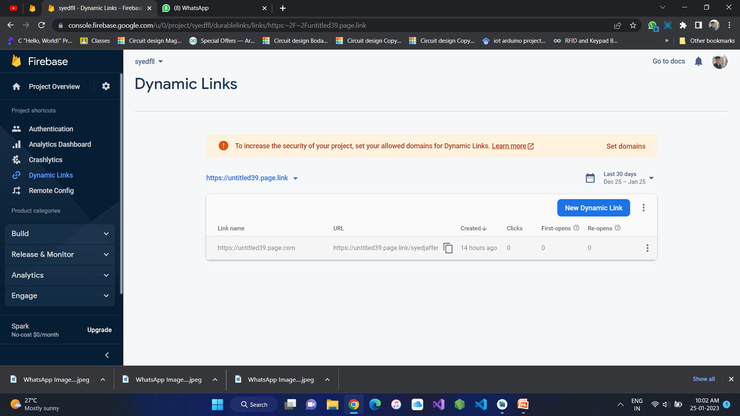

Slide 17
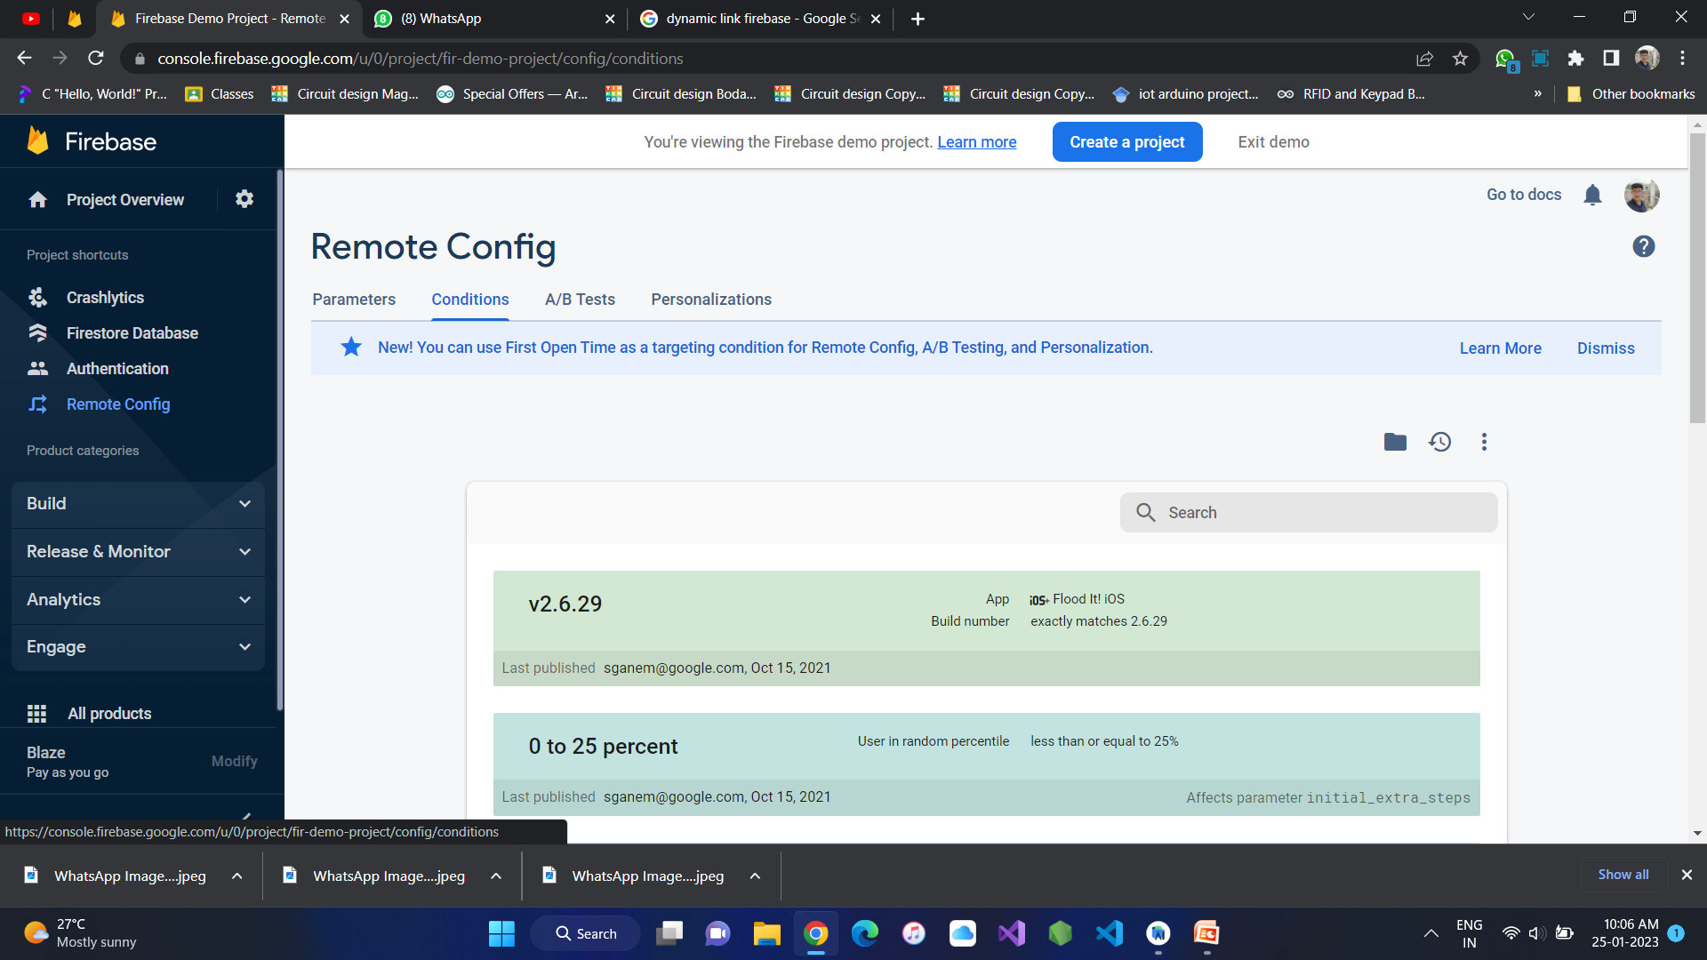
Remote Config

Slide 18
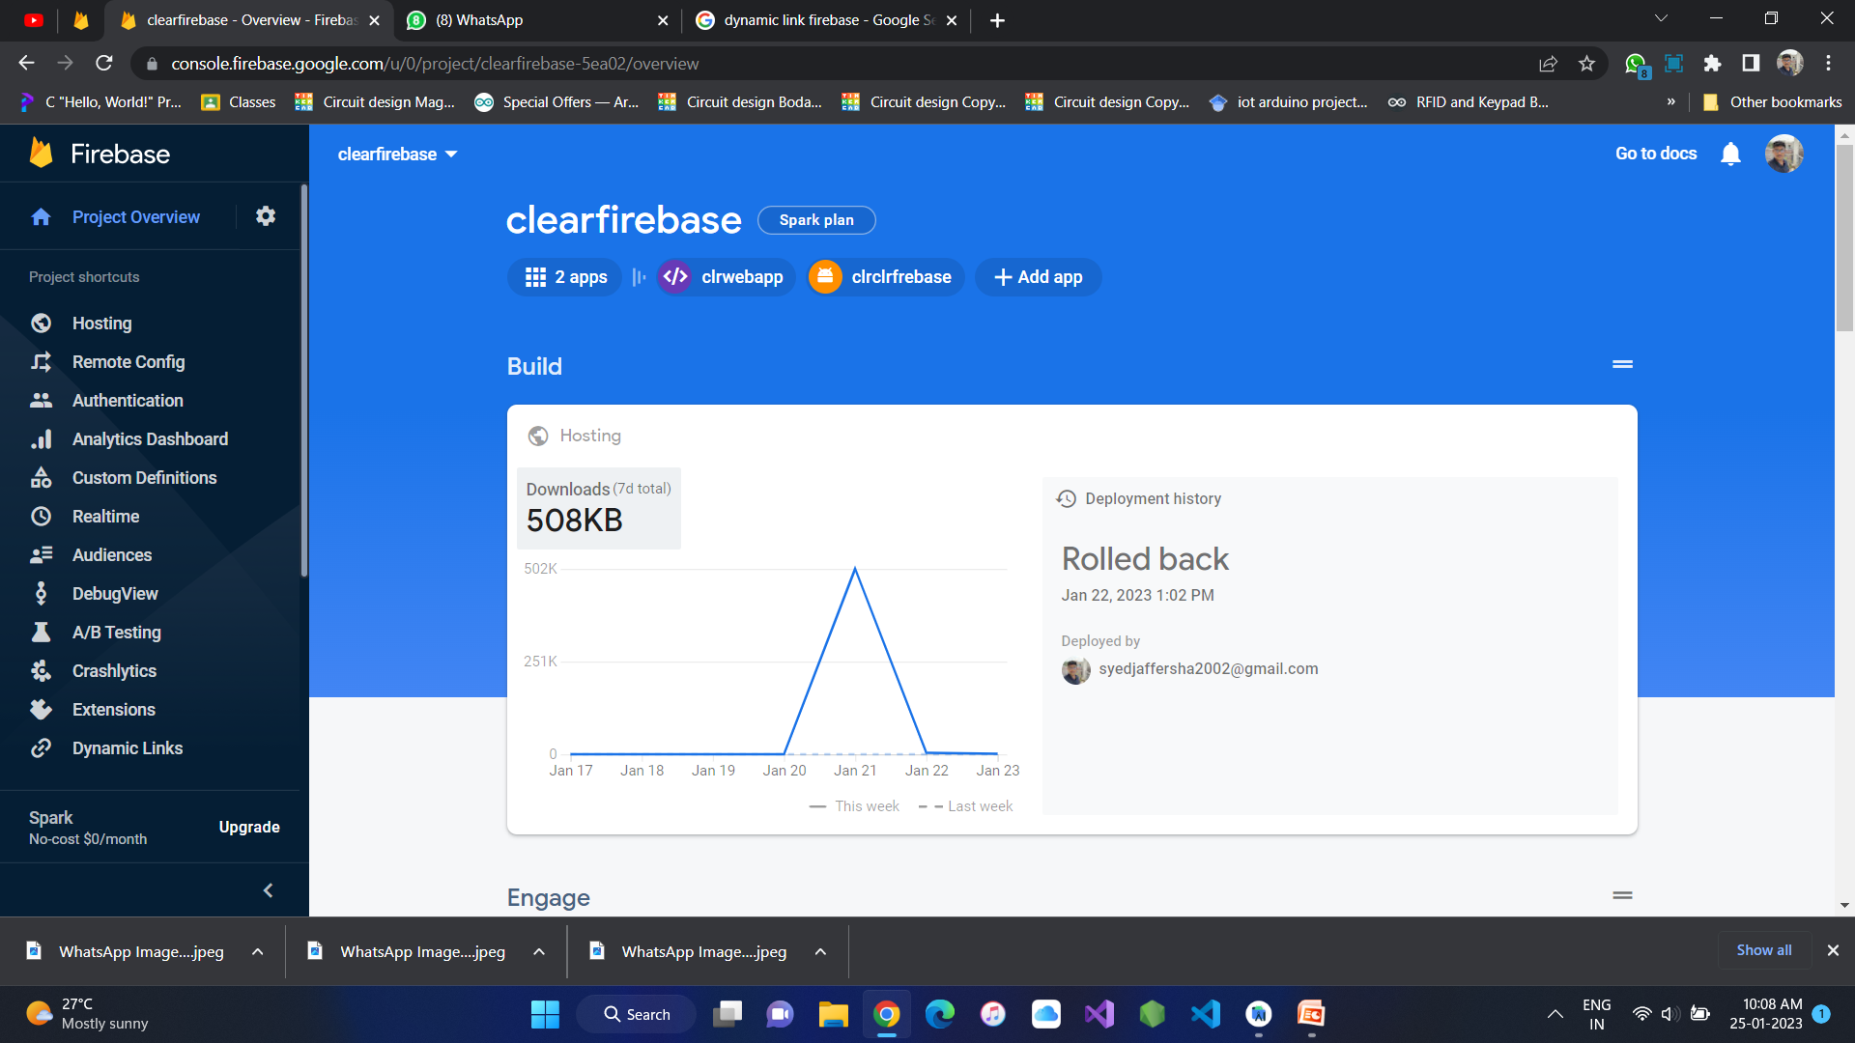
Hosting

